Slide 1
Housing Price Prediction
Gloria Shen, Junfeng Li, Yuehai Shen

Slide 2
Topic & Objectives
We are predicting the housing sales price in California. In order to improve the accuracy of our prediction, we will only focus on the house price for sale.
Combining different data such as housing price data, cities demographics data, and neighborhood reviews data.

Slide 3
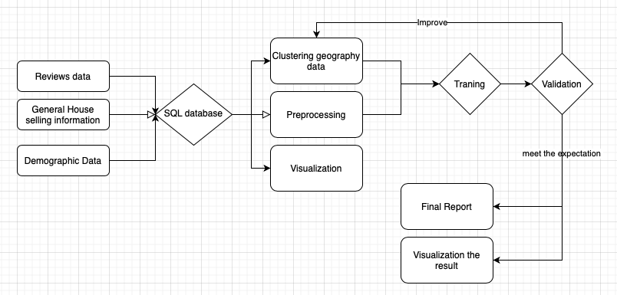
General Approach

Slide 4
Datasets
General housing sale information data: Features includes price, number of rooms, area, etc. Likely to get it from Realtor APIs or web scraping.
Cities demographic data: The basic data we are expecting includes population, median income, and average age. We plan to use some open source data online.
Reviews of neighborhood data: A main challenge. Important information are sentiment and rating toward the neighborhoods. We will initially search for reviews of major neighborhood.

Slide 5
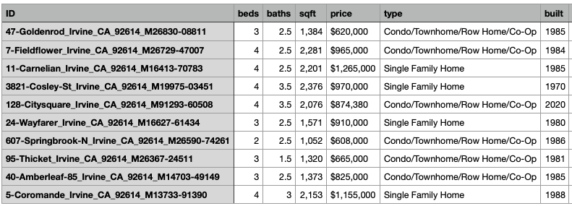
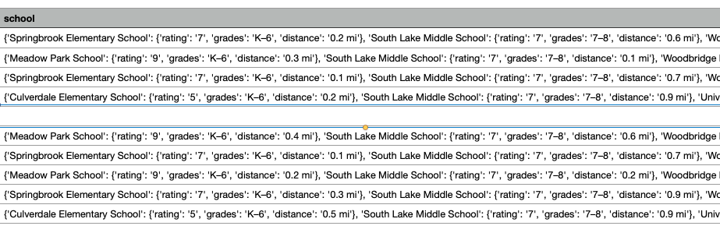
Datasets -realtor

Slide 6
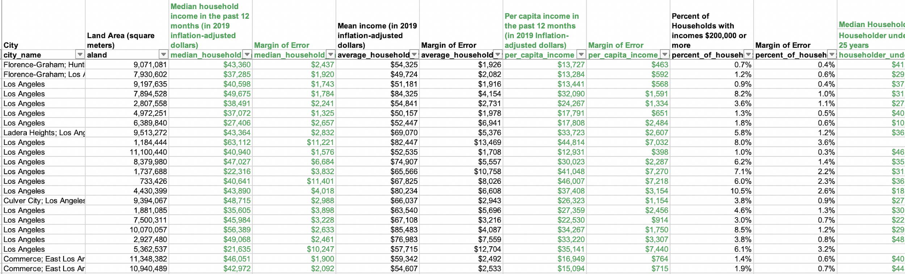
Datasets - demographic
- Median Households, Mean income, Per capital income in the past 12 months, percent of households with income more than 200,000, Median household Income by Age of Householder, age&sex and educationl level and unemployement.

Slide 7
Machine Learning modeling
Unsupervised learning: We will use clustering to divide cities into different groups based on demographic characteristics during data preprocessing stage.
Supervised learning: We will try different methods such as linear regression and random forest. After getting the most accurate results, we will try to solve overfitting issue if there is any.

Slide 8
Experiments and Evaluation
Dimension reduction by using PCA and TSNE.
Split data into 70%(Training):30%(Testing)
Machine Learning training
Test out different variables and see which are significant predictors
Validate and minimize MSE
Come up with and get some new variables if the accuracy is not as expected

Slide 9
Softwares
Python - Jupyter Notebook/Colab
Github - Collaboration
Psql - Store data
Tableau - Data visualization

Slide 10
Timeline
Week 9-10 Winter: Data collection; Finalizing ideas of project
Week 1-2 Spring: Data collection and wrangling
Week 3-4 Spring: Train different ML models
Week 5-6 Spring: Train different ML models
Week 7-8 Spring: Test models and validation
Week 9-10 Spring: Final report and data visualization

